Slide 1
PYTHON TUTORIALS
Introduction

Slide 2
What is Python?
Python is a high-level widely used general-purpose programming language :
It is an object-oriented programming language
It was created by Guido van Rossum in 1991

Slide 3
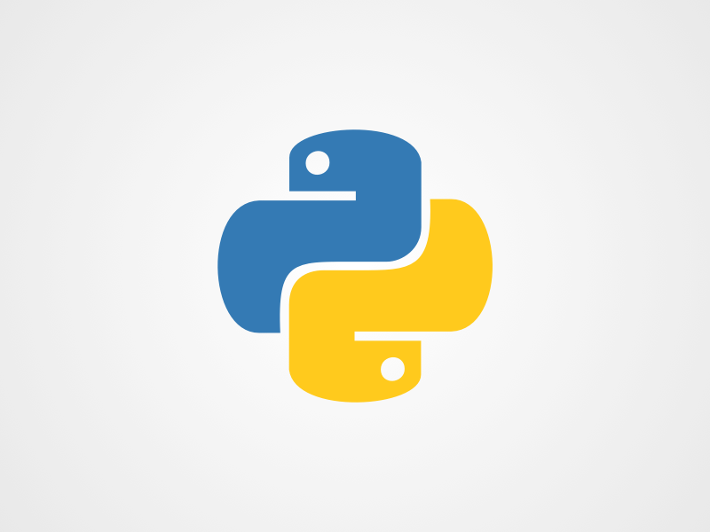
Python Logo

Slide 4
What is python used for?
AI and machine learning
Data analytics
Data visualisation
Programming applications
web development (server-side)
Game development
And Many more..

Slide 5
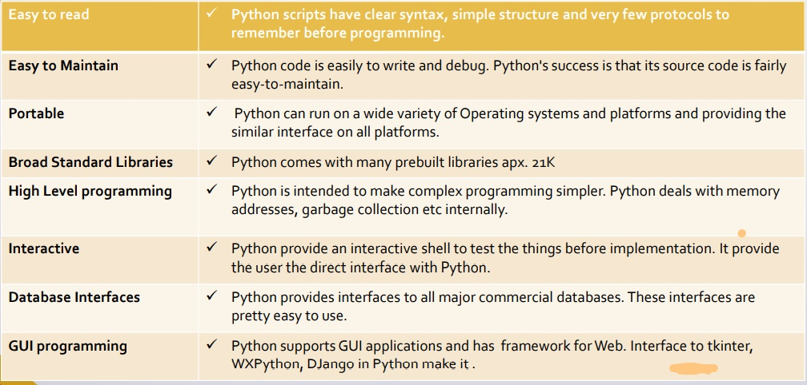
Why Python?

Slide 6
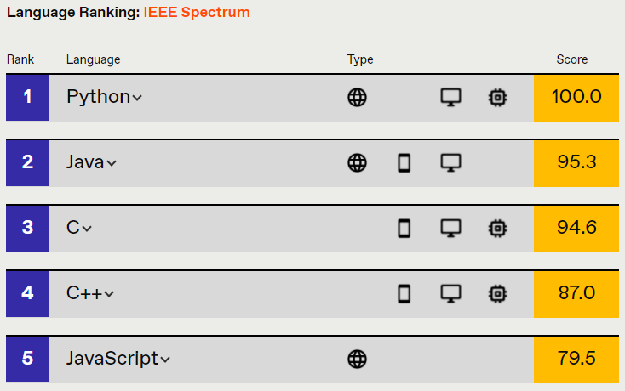
Ranking

Slide 7
Python Syntax
print("Hello, World!")

Slide 8
Features
Easy to Write
Easy to Understand
Object-Oriented
Robust Standard Libraries
Dynamically Typed and Type Checking
Databases
Extensible
Portable
Free and Open Source

